Slide 1
Networking and Internet

Slide 2
Networking: Computers on the Internet
1969 – 4
1971 – 15
1984 – 1000
1987 – 10,000
1989 – 100,000
1992 – 1,000,000
1996 – 10,000,000
2001 – 100,000,000
By 2005… billions

Slide 3
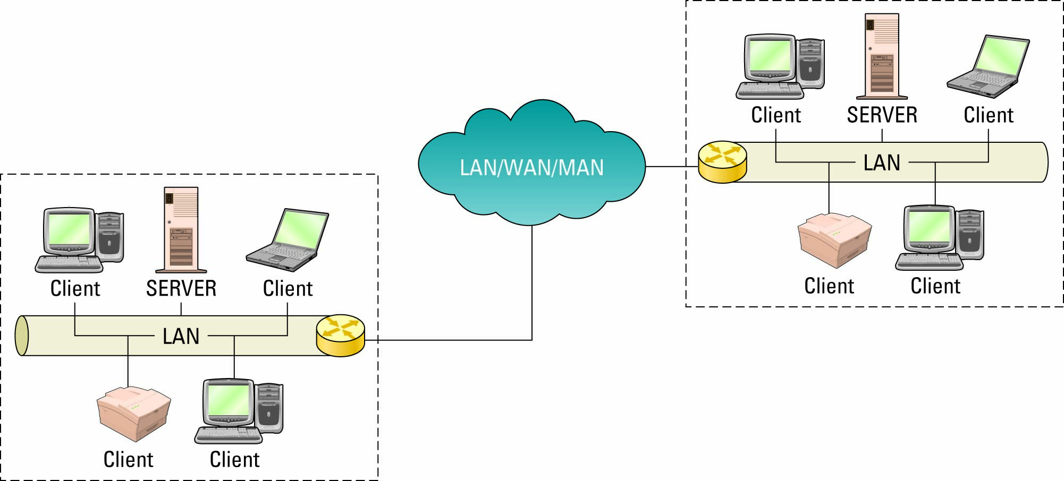
Client/Server Networks
Client/Server network

Slide 4
Network Hardware
The most essential networking hardware devices for us to learn about are:
Cables
NICs
Hubs
Switches
Routers

Slide 5
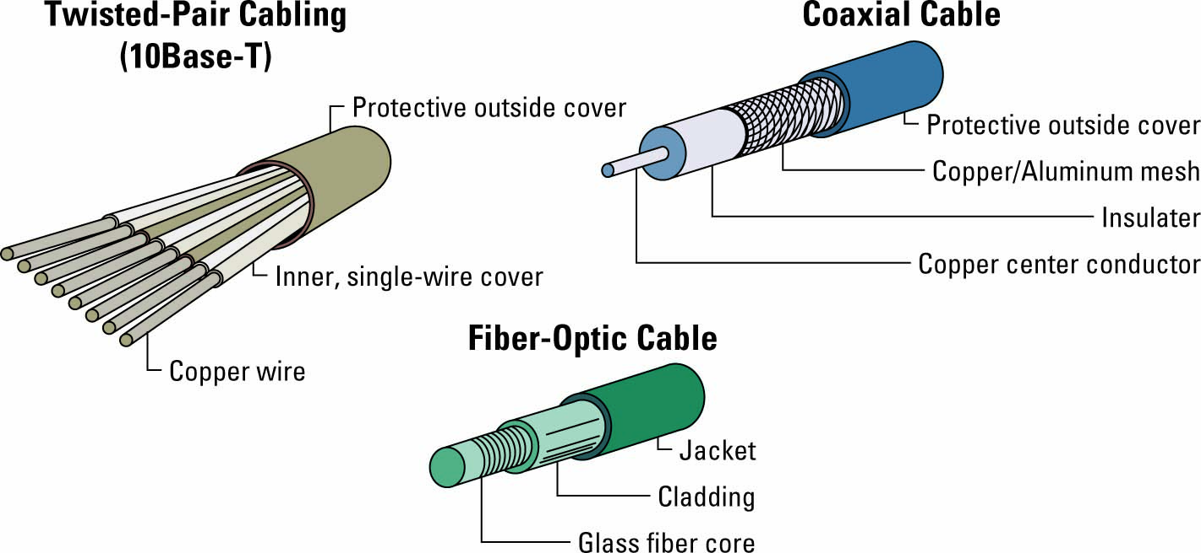
Wire Media

Slide 6
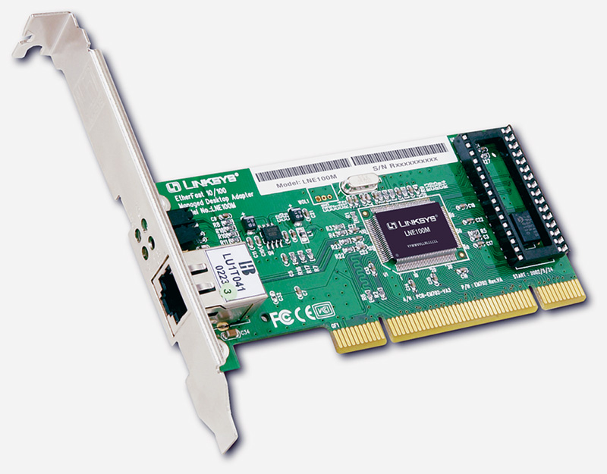
NIC – a “Network Interface Card”
Every networked device must have a NIC
Most laptops today have both a wired NIC and a wireless NIC
Each NIC has an IP address (it’s “logical address”) and a physical address called a MAC address.
Each NIC is given an address at the factory that is the device’s physical address or MAC address.
No two NIC devices will ever have the same MAC address.
MAC Addresses are used within a LAN
IP addresses allow routers to route a message across different networks
when a message reaches the correct destination network, the correct NIC is identified via its MAC address.

Slide 7
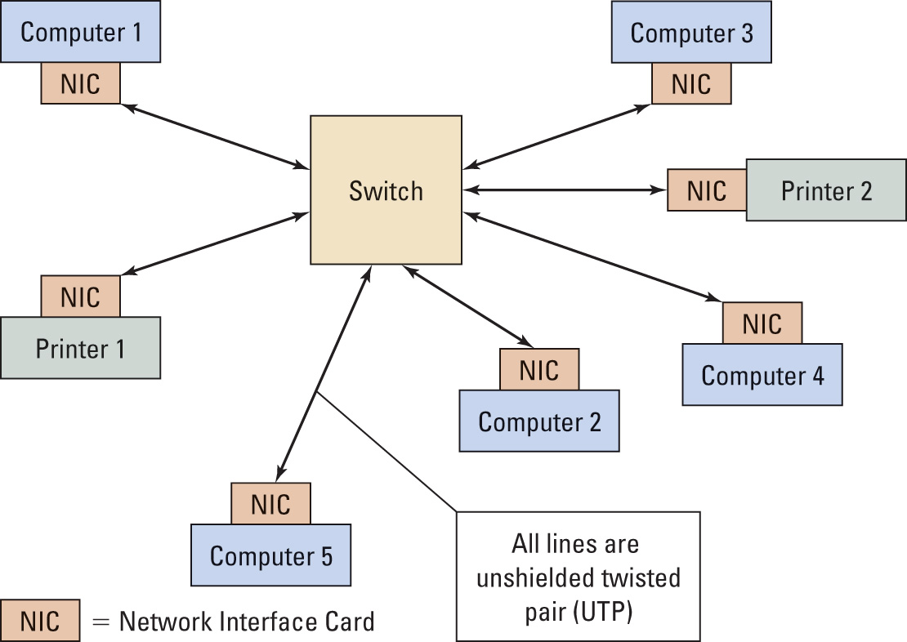
Typical LAN “Local Area Network”
Hub or switch

Slide 8
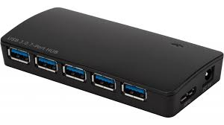
Hubs
A “hub” is a networking component that into which you can plug in multiple network devices
Connect computers, printers, scanners, etc.
Anytime a connected device sends a network message, the hub forwards the message to all other connected devices (not just the intended recipient!)
Hub can only deal with one message at a time, since it is broadcast over all connections

Slide 9
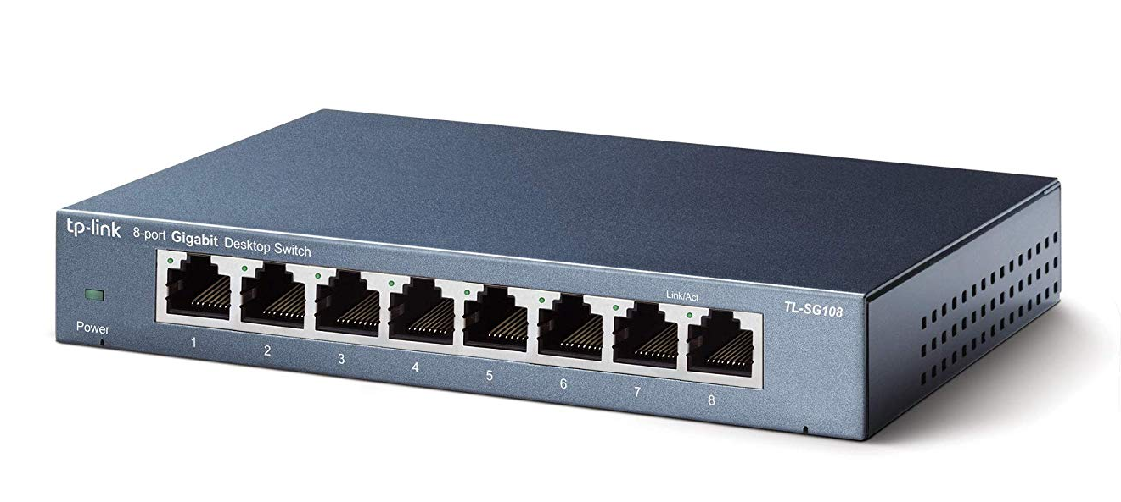
Switches
A switch is a network device which directs traffic only to its intended destination(s) rather than to all devices on the network.
sometimes referred to as an “intelligent hub”
Provide a dedicated connection between individual devices
multiple devices can send data at once

Slide 10
A Network Switch
Switch receives
data
and sends
it back out
Switch
Switch sends
signal out to a
single Port
Station A
Transmits
to Station C
Station
A
Station
B
Station
C
Station
D

Slide 11
Routers
Different networks connect via routers (not switches or hubs)
Routers even connect networks based on different protocols, which is important since not all networks use the same protocol.
Network X
Switches
Routers
Network Z
Switches

Slide 12
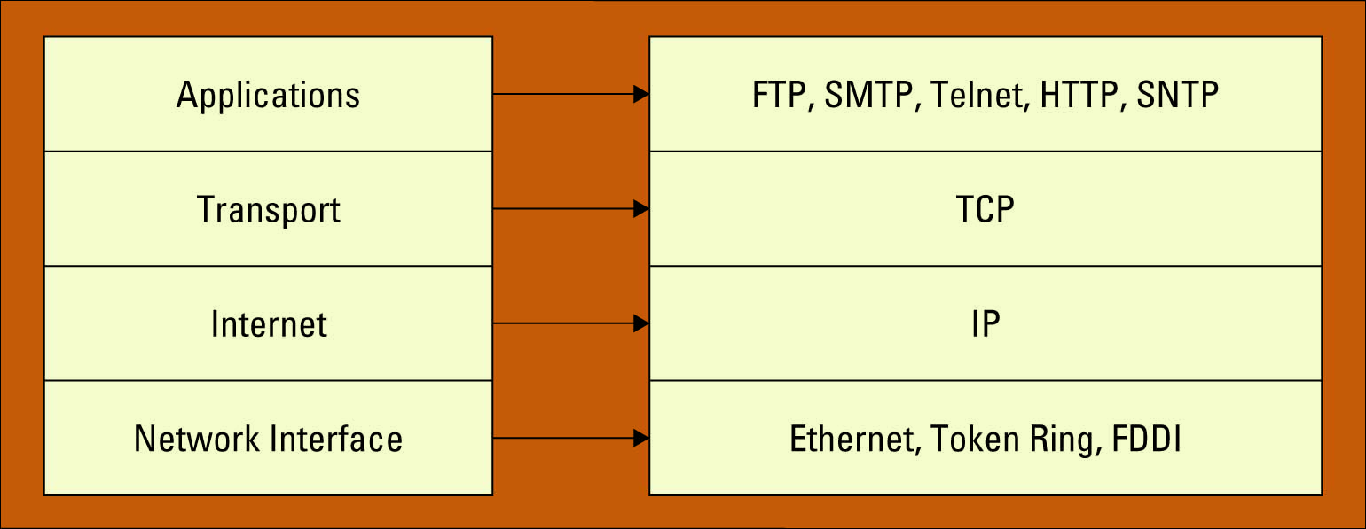
TCP/IP
Transmission Control Protocol/Internet Protocol (TCP/IP) provides the technical foundation for the public Internet as well as for large numbers of private network. It is defined in terms of layers.
Do you use TCP/IP?
If you are on the Internet, yes, you are using TCP/IP.
TCP/IP layers (at left, with particular implementations at right)

Slide 13
A TCP/IP network packet
Here is the basic structure of any one of trillions of packets traversing the Internet at this moment
Packet
Trailer
Data Field
Header
IP Address
Sender Field
IP Address
Destination Field

Slide 14
LAN TECHNOLOGIES

Slide 15
Technology Options
Ethernet
Fast Ethernet
Gigabit Ethernet
10 Gig Ethernet
WLAN

Slide 16
Ethernet
Ethernet (pronounced "eether net") is a computer network technology which is used in different area networks like LAN, MAN, WAN.
Ethernet connecting computers together with cable so the computers can share information. Within each main branch of the network, "Ethernet" can connect up to 1,024 personal computers and workstations.

Slide 17
Ethernet Address
End nodes are identified by their Ethernet Addresses (MAC Address or Hardware Address) which is a unique 6 Byte address.
MAC Address is represented in Hexa Decimal format e.g 00:05:5D:FE:10:0A
The first 3 bytes identify a vendor (also called prefix) and the last 3 bytes are unique for every host or device

Slide 18

Ethernet Frame Structure
Preamble:
7 bytes with pattern 10101010 followed by one byte with pattern 10101011
Used to synchronize receiver, sender clock rates
Addresses: 6 bytes, frame is received by all adapters on a LAN and dropped if address does not match
Length: 2 bytes, length of Data field
CRC: 4 bytes generated using CR-32, checked at receiver, if error is detected, the frame is simply dropped
Data Payload: Maximum 1500 bytes, minimum 46 bytes
If data is less than 46 bytes, pad with zeros to 46 bytes
Length

Slide 19
Fast Ethernet
100 Mbps bandwidth
Uses same CSMA/CD media access protocol and packet format as in Ethernet.
100BaseTX (UTP) and 100BaseFX (Fiber) standards
Full Duplex/Half Duplex operations.

Slide 20
Gigabit Ethernet
1 Gbps bandwidth.
Uses same CSMA/CD media access protocol as in Ethernet and is backward compatible (10/100/100 modules are available).
1000BaseT (UTP), 1000BaseSX (Multimode Fiber) and 1000BaseLX (Multimode/Singlemode Fiber) standards.

Slide 21
10 Gig Ethernet
10 Gbps bandwidth.
Uses same CSMA/CD media access protocol as in Ethernet.
Propositioned for Metro-Ethernet

Slide 22
Wireless networking
Bluethooth
Wireless fidelity (wi-fi) – a means of linking computers into a wireless local area network (WLAN)
Wi-Max

Slide 23
What is bluetooth?
Bluetooth wireless technology is an open specification for a low-cost, low-power, short-range radio technology for ad-hoc wireless communication of voice and data anywhere in the world.

Slide 24
Intoduction
1994 Ericsson gets interested in wireless connections from mobile telephones to other devices like PDAs and accessories like Headsets
Forming the SIG (Special Interest Group) with 4 other members (IBM, Intel, Nokia, Toshiba) in order to develop a wireless standard for communication between mobile devices

Slide 25
Overview
Originally conceived as a cable replacement technology
Other usage models began to develop:
Personal Area Network (PAN)
Ad-hoc networks
Data/voice access points
Wireless telematics

Slide 26
Ad-hoc-networking
piconet
decentral, one master up to 7 slaves
up to 255 parked slaves
point to point or point to multipoint conn
unique bluetooth device address
scatternet
overlapping of two piconets, up to 10
different hopping sequences
peer to peer (P2P) network

Slide 27
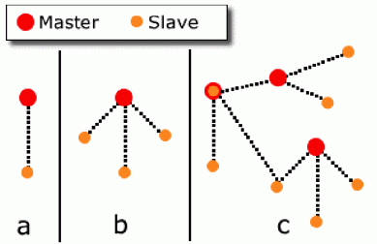
Ad-hoc-networking
a: piconet with a single slave
b: piconet with a multi slave
c: scatternet

Slide 28
Products
Notebook PCs & desktop computers
Printers
PDAs
Other handheld devices
Cell phones
Wireless periperals:
Headsets
Cameras
Access Points
CD Player
TV/VCR/DVD
Telephone Answering Devices
Cordless Phones
Cars

Slide 29

Wireless Fidelity (Wi-Fi)

Slide 30
Introduction
Wireless Technology is an alternative to Wired Technology, which is commonly used, for connecting devices in wireless mode.
A Wi-Fi is an electronic devices, such as a personal computer, video game console, Smartphone, or digital audio player can connect to the internet via a wireless network access point.
An access point (or hotspot) has a range of about 20 meters (65 feet) indoors as few rooms and a greater range outdoors, as many square miles.
Wi-Fi access can provide at Organizations and businesses such as homes, offices, airports, hotels and restaurants often provide free-use hotspots to attract or assist clients.

Slide 31
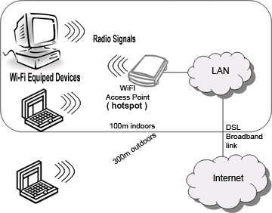

How Wi-Fi works?
There are three most important items which makes Wi-Fi working in your laptop or desktop. These are,
Radio Signals
Wi-Fi Card which fits in your laptop or computer.
Hotspots which create Wi-Fi Network.

Slide 32
Wi-Fi Technology
Wi-Fi (Wireless Fidelity) is a generic term that refers to the IEEE 802.11 communications standard for Wireless Local Area Networks (WLANs).
The 802.11 standard is defined through several specifications of WLANs such as,
IEEE 802.11b
IEEE 802.11a
IEEE 802.11g

Slide 33
How to connect Wi-Fi Network?
Basic concept is same as Walkie talkies.
A Wi-Fi hotspot is created by installing an access point to an internet connection.
An access point acts as a base station.
When Wi-Fi enabled device encounters a hotspot the device can then connect to that network wirelessly.
A single access point can support up to 30 users and can function within a range of 100 – 150 feet indoors and up to 300 feet outdoors.
Many access points can be connected to each other via Ethernet cables to create a single large network.

Slide 34
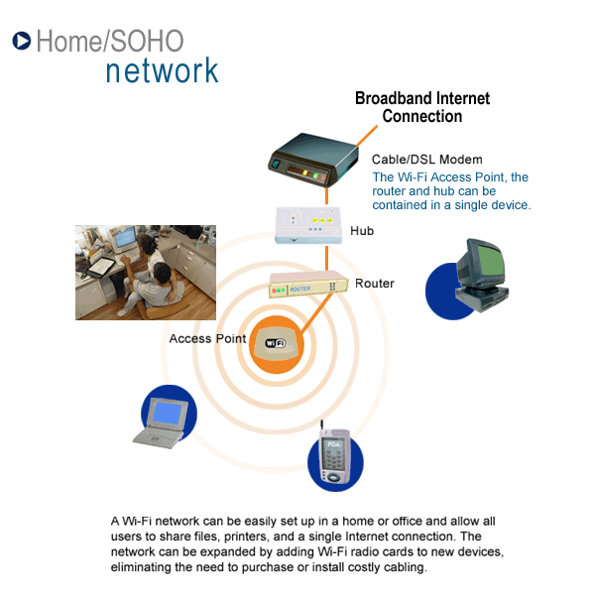
Whole house connectivity

Slide 35
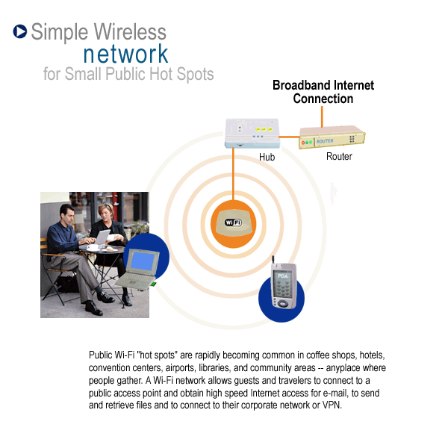
Public place connectivity

Slide 36
Advantages
Mobility
Ease of Installation
Flexibility
Cost
Reliability
Security
Use unlicensed part of the radio spectrum
Roaming
Speed

Slide 37
What is Wimax ?
WiMAX is a wireless digital communications system, also known as IEEE 802.16, that is intended for wireless "metropolitan area networks".
WiMAX can provide broadband wireless access (BWA) up to 30 miles (50 km) for fixed stations, and 3 - 10 miles (5 - 15 km) for mobile stations.
In contrast, the WiFi/802.11 wireless local area network standard is limited in most cases to only 100 - 300 feet (30 - 100m).

Slide 38
Internet Structure / Protocol

Slide 39
Objectives
Obtain the basic knowledge of computer networking and the Internet
Concepts of network applications, Internet
Basic knowledge of network protocols: TCP/IP

Slide 40
What is the Internet?
Application
Web, Email…
Application
Transport
TCP, UDP
Transport
Network
IP
Network
Data Link
Ethernet, cellular
Data Link
Physical link

Slide 41
Some Internet applications
E-mail
Web
Instant messaging
Remote login
P2P file sharing
Multi-user network games
Streaming stored video clips
Internet telephone
Real-time video conference
Massive parallel computing

Slide 42
Internet
Internet: loosely hierarchical “network of networks”
Major Components: Hosts, Routers, Communication links
Protocols: for sending, receiving of msgs
e.g., TCP, IP, HTTP, FTP, PPP
Internet standards
RFC: Request for comments
IETF: Internet Engineering Task Force
router
workstation
server
mobile
local ISP
regional ISP
company
network
42

Slide 43
Internet: Three Components
End systems (hosts): millions of connected computing devices executing network applications
Routers: forwarding packets (chunks of data)
Communication links:
Connecting hosts and routers
fiber, copper, radio, satellite
transmission rate = bandwidth
router
workstation
server
mobile
local ISP
regional ISP
company
network
43

Slide 44
Protocol
network protocols:
all communication activity in Internet governed by protocols
Protocols define format, order of messages sent and received among network entities, and actions taken on message transmission, receipt

Slide 45
Network edge: connection-oriented service
TCP [ Transmission Control Protocol ]
reliable, in-order : byte-stream data transfer
loss: acknowledgements and retransmissions
flow control:
sender won’t overwhelm receiver
congestion control:
senders “slow down sending rate” when network congested
Examples of applications using TCP:
HTTP (Web), FTP (file transfer), SSH (remote secure login), SMTP (email)

Slide 46
Client-Server Model

Slide 47
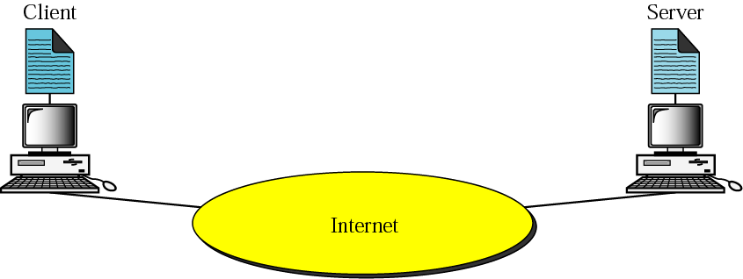
15.1 Client-server model
To make any use of the Internet, application programs should run on the two endpoints of a network connection.
The applications are the entities that communicate with each other to exchange services
“Client” applications request service
“Server” applications provide service.

Slide 48
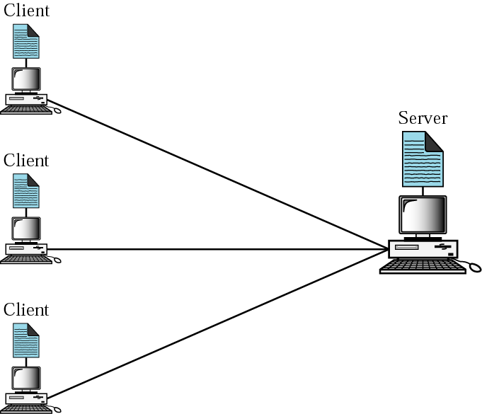
Client-Server Relationship: Many-to-One
Servers
Run all the time (i.e. infinite)
Provide service to any client
Typically specialize in providing a certain type of service, e.g. Mail.
Listen to a well-known port and passively open connection.
Clients
Run when needed, then terminate (i.e. finite)
Actively Open TCP or UDP connection with Server’s socket.

Slide 49
Concurrency
Operation mode could be either iterative or concurrent.
In clients:
Iterative mode: One client at-a-time in serial
Concurrent mode: Several clients run at the same time
In servers:
Iterative mode: serve one client at-a-time (clients wait in a queue)
Concurrent mode: serve multiple clients concurrently and independently.

Slide 50
Data Capture

Slide 51
Outline
why use automatic identification?
technologies
bar code
cards
radio frequency tags
other
applications

Slide 52
Why AutoID?
identify items
eliminate errors in data collection
speed up data collection
track items
store information about items

Slide 53
AutoID Technologies
bar codes
1D (linear)
2D (stacked or matrix)
cards
magnetic stripe
smart
optical
radio frequency tags
contact memory
voice

Slide 54
1D (Linear) Bar Codes
most widely used technology
bars and spaces
may be numeric or alphanumeric
low storage capacity (15-50 characters)
usually used as “license plate”
most used codes: UPC, I-2/5, Code 39, Code 128

Slide 55
UPC Code
retail applications
numeric, 12 digits
format
a character has
2 bars and 2 spaces
7 modules (bar, space is 1, 2, 3 or 4 modules wide)
dark module = 1, light module = 0
left and right are different

Slide 56
Interleaved 2 of 5 Code
industrial applications (distribution)
numeric, any even number of digits
format
start and stop characters are different
a character has
5 bars or 5 spaces
2 are wide, 3 are narrow
odd digits are bars, even are spaces

Slide 57
Code 39 (3 of 9)
industrial applications
numeric and upper case alpha, any length
format
start and stop characters are the same
has intercharacter gap
a character has
5 bars and 4 spaces
2 bars and 1 space are wide

Slide 58
Code 128
industrial applications
full ASCII character set, any length
format
different start and stop characters
uses a check character for error detection
a character has
3 bars and 3 spaces
11 modules total (bar, space is 1, 2, 3, or 4 modules wide)

Slide 59

2 Dimensional Barcodes
Portable Data Base
Formats
Stacked
Matrix
PDF417
stacked code
up to 2000 characters
error correction

Slide 60
2 D Barcodes (cont.)
Data Matrix
matrix, up to 500 characters, error correction
scaleable down to .001 in square
marking small items – IC’s, single dose meds
Maxicode
matrix, 93 characters, error correction
1 inch square, locating bullseye
package sortation and tracking

Slide 61
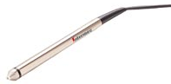
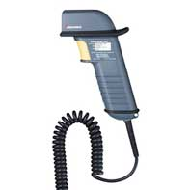
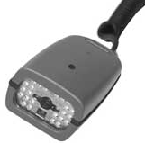
Bar Code Readers
handheld or fixed mount
contact wands (pens)
slow, inexpensive
laser scanners
longer distance scanning
fixed or handheld
can read stacked bar codes
image scanners
fixed or handheld
can read stacked bar or matrix codes
Notes:
photos: Intermec corp

Slide 62
Cards
magnetic stripe
low cost
low storage capacity
contact reader
can be rewritten
easily damaged (less easily for high coercivity stripes)
example: credit cards, bank cards

Slide 63
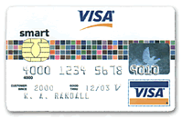
Cards (cont.)
“smart cards”
imbedded microchip
memory only – stored value cards
microprocessor
high storage capacity
can be rewritten
can execute programs
example: some credit cards
Notes:
photo: Visa

Slide 64
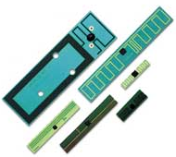
Radio Frequency Tags
transponder (tag) is programmed with information
reader has an antenna which sends radio signals to activate tag, read or write it
types of tags
active (has battery)
read and write
passive (activated by reader)
– often read-only
noncontact, non line-of-sight
Notes:
photo: Intermec

Slide 65
RFID Applications
railroad cars, commercial trucks
automobiles on assembly lines
parts carriers in hazardous environments
toll collection on highways
theft prevention in retail

Slide 66
Why RFID?
tags can be used in harsh conditions
usually housed in protective packaging
tags can be read over distances greater than 90 feet
tags can be read through snow, grime, cutting fluid, paint, etc.
tags can be read at high speed
more costly than bar code
lack of standardization between manufacturers

Slide 67


Contact Memory
a memory chip in a stainless steel case that resembles a button battery
read by touching the case with a probe
read only or read-write
license plate or portable database
additional capabilities can be built in
real-time clock
temperature sensor
cryptography
Notes:
photos: Dallas Semiconductor Corp.

Slide 68
Use of Contact Memory
asset tracking
access control
digital cash
maintenance records
store manufacturing history for products

Slide 69
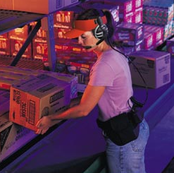
Voice Data Collection
hands free
easy to use
must be “trained” to recognize operator
Notes:
photo: Syvox Corporation

Slide 70
Application Layer Functionality and Protocols
TCP / IP Application Layer

Slide 71
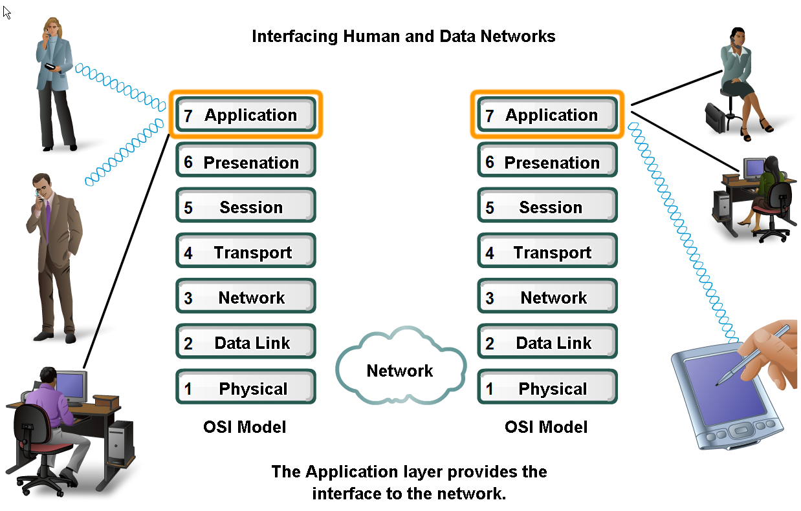
Applications Layer – allows user to interface with the network!

Slide 72
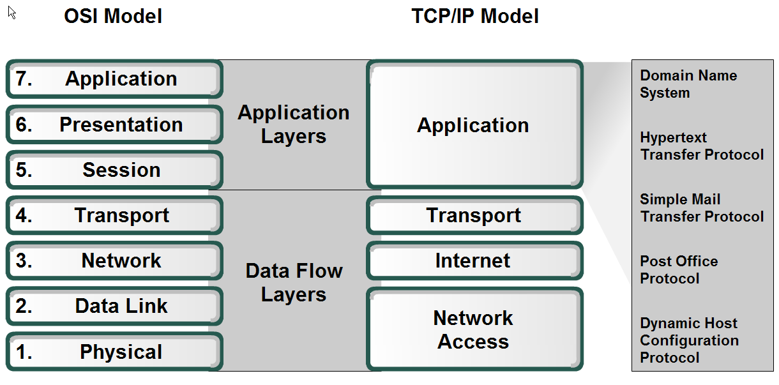
Application Layer – Provides the interface between the applications on either end of the network.

Slide 73
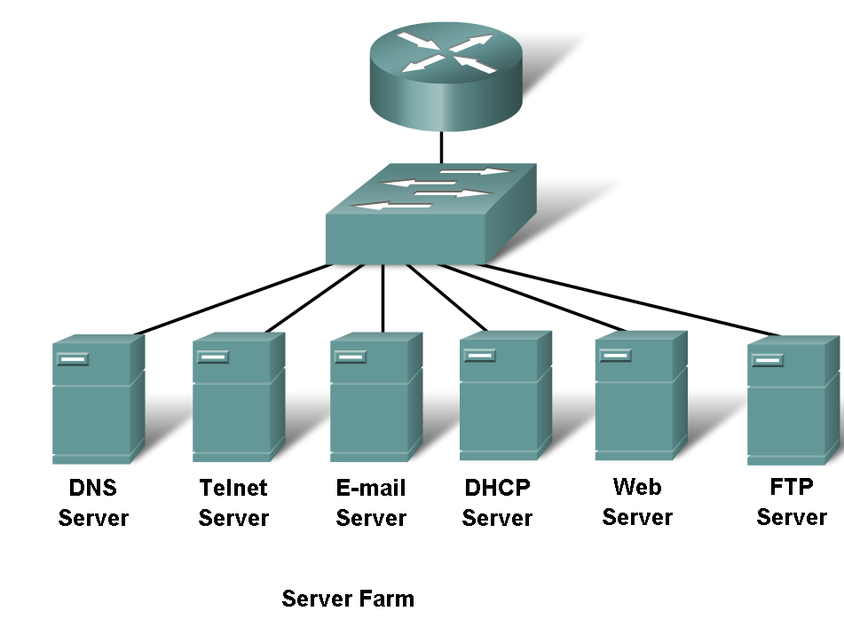
Protocols and networks

Slide 74
Protocols
DNS – Matches domain names with IP addresses
HTTP – Used to transfer data between clients/servers using a web browser
SMTP & POP3 – used to send email messages from clients to servers over the internet
FTP – allows the download/upload of files between a client/server
Telnet – allows users to login to a host from a remote location and take control as if they were sitting at the machine (virtual connection)
DHCP – assigns IP addresses, subnet masks, default gateways, DNS servers, etcs. To users as they login the network

Slide 75
Application layer software
2 types
Applications – Provide the human (user) interface. Relies on lower layers to complete the communication process.
Services – establish an interface to the network where protocols provide the rules and formats that govern how data is treated..

Slide 76
How data requests occur & are filled
Client/server model
Advantages:
Centralized administration
Security is easier to enforce
Application layer services and protocols
Peer-to-peer networking and applications

Slide 77
Client/Server Model
Client –
device requesting information (initiates the data exchange)
Can also UPLOAD data to the servers
Server – device responding to the request
How does it handle multiple request from multiple users and keep everything in order?
Relies on support from the lower layer functions to distinguish between services and conversations.
Server relies on a service called a server daemon – runs in the background and ‘listens’ for requests for that service. It can then exchange messages as appropriate & send requested data.
Examples:
E-mail Client on an employee computer issues a request to the e-mail server for any unread e-mail. The server responds by sending the e-mail to the client.
Conversations can originate with either party.

Slide 78
Peer-to-Peer (P2P) Network Model
Two or more computers are connected and are able to share resources without having a dedicated server
Every end device can function as a client or server on a ‘per request’ basis
Resources are decentralized (information can be located anywhere)
Difficult to enforce security and policies
User accounts and access rights have to be set individually on each peer device

Slide 79
P2P Applications
Running applications in hybrid mode allows for a centralized directory of files even though the files themselves may be on multiple machines
Unlike P2P networks, a device can act as both the client and server within the same communication
Each device must provide a user interface and run a background service.
Can be used on P2P networks, client/server networks and across the internet.

Slide 80
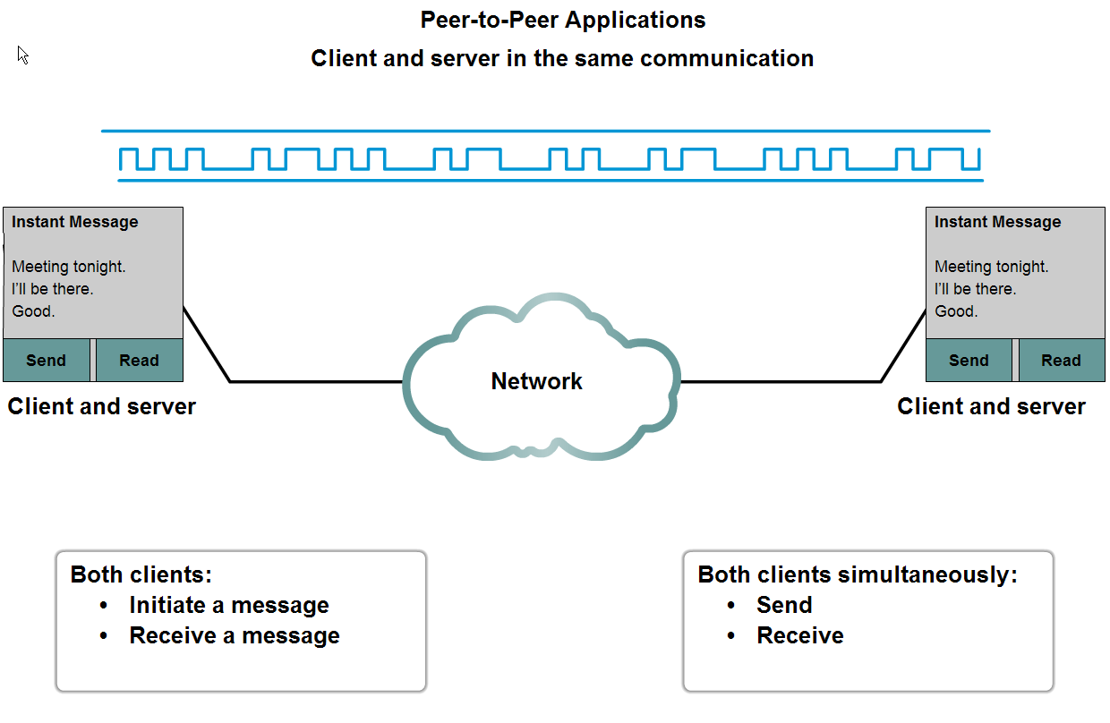
P2P Applications Example

Slide 81
Common Port Numbers
TCP
FTP – 20-21
Telnet – 23
SMTP – 25
DNS – 53 (Both TCP & UDP)
HTTP – 80
UDP
DHCP – 67 & 68
POP – 110

Slide 82
DNS Services
DNS resolver – supports name resolution for other network applications and services that need it.
Devices are usually given 1 or more DNS Server addresses they can use for name resolution.
Uses different types of resource records to actually resolve the name/IP address issues

Slide 83
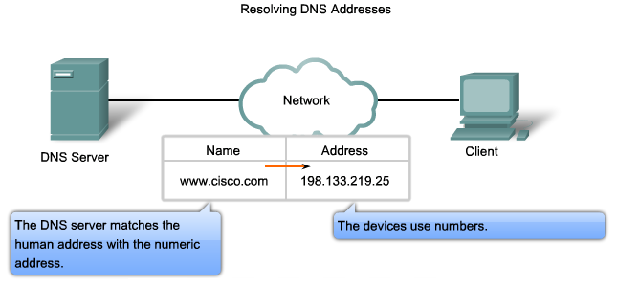
DSN Services and Protocol
DNS Servers resolve names to IP addresses. It would be difficult to remember the IP address of every website we like to visit, but we can remember names.
THANK YOU DNS SERVER!

Slide 84
WWW Service and HTTP
Steps:
1) URL is typed in the address bar.
Browser checks with DNS server to convert it to an IP address
Connects to the server requested
Using HTTP or HTTPS protocol requirements, the browser sends a GET request to the server to ask for the desired html document (usually index.html)
The server sends the HTML code for the web page to the browser.
The browser interprets the HTML code and formats the page to fit the browser window.
See the next slide for an example.

Slide 85
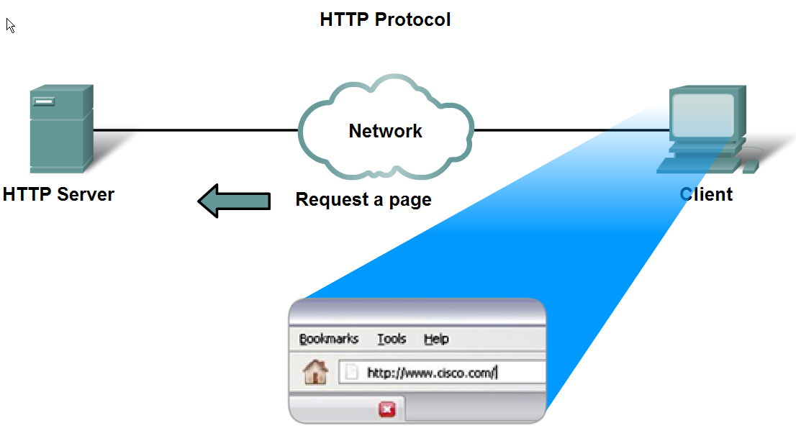
WWW Service and HTTP
HTTP/HTTPS are some of the MOST used application protocols!

Slide 86
E-mail services and SMTP/POP protocols
E-mail is the most popular network service.
E-mail client (when people compose e-mail) is called Mail User Agent (MUA)
MUA allows messages to be sent/retrieved to and from your mailbox
Requires several applications and services
POP or POP3 – deliver email from server to client (incoming messages)
SMTP – handles outbound messages from clients

Slide 87
E-mail services and SMTP/POP protocols
What do servers require?
Must be running SMTP!
Also operates
Mail Transfer Agent (MTA) – used to forward email
Receives email from the clients MUA
Uses SMTP to route email between SERVERS!
Passes email to the MDA for final delivery
Mail Delivery Agent (MDA) – receives messages from MUA or from the MTA on another server
For two e-mail servers to talk – MUST run SMTP and MTA in order to transfer mail between the 2 servers!
Some clients run Lotus Notes, Groupwise, or MS Exchange. They have their own proprietary protocol for handling e-mail.

Slide 88
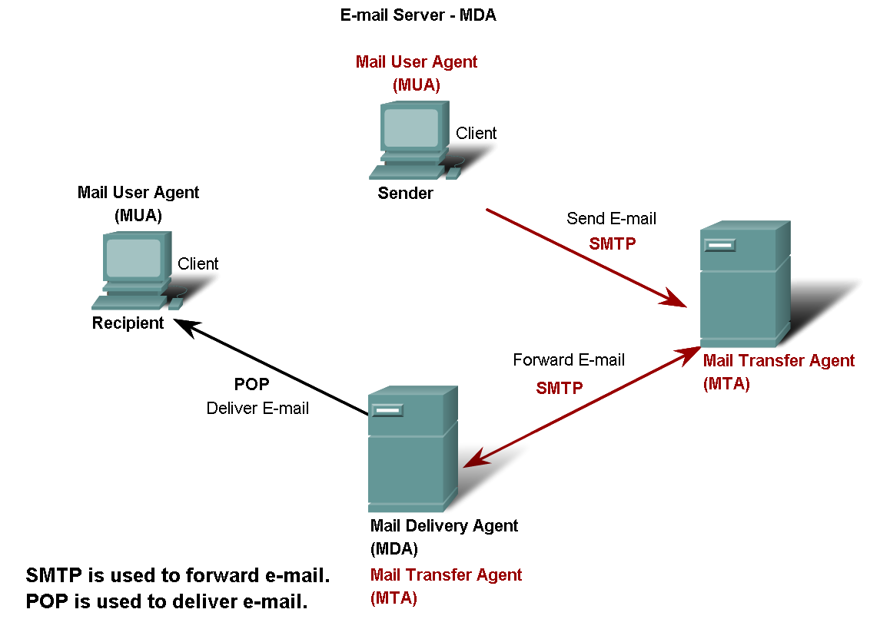
E-mail services and SMTP/POP protocols

Slide 89
FTP
Commonly used application layer protocol
Allows for the transfer of files between clients/servers.
Requires 2 connections to the server
Commands – uses TCP port 21
Actual data – uses TCP port 20

Slide 90
DHCP
Dynamic Host Configuration Protocol – enables devices to obtain IP addresses, subnet masks, gateways, DNS server information, etc. from a DHCP server.
An IP address that is not being used is assigned from a range of available addresses
Not permanently assigned – only leased for a specific period of time (usually 24 hours – 7 days)
If the host logs off or the power is lost, the IP address they were using is returned to the pool to be re-assigned to another host when needed.
This is how you are able to use Wi-Fi at various places in the world!
Don’t use DHCP for devices such as servers, printers, routers, switches, etc. These should be statically assigned.
This will be covered in greater detail in CCNA 4.

Slide 91
Telnet
Developed in the early 1970’s – among the oldest of the application layer protocols and services in the TCP/IP protocol suite.
Allows users to emulate text-based terminal devices over the network using software.
A connection is known as a ‘virtual terminal (vty)’ session.
Can be run from the command prompt on a PC.
You can use the device as if you were sitting there with all the rights and priorities that you username will offer you.
Disadvantages: Doesn’t support encryption like SSH. All data is transferred as plain text. It can be easily intercepted and understood.
If security is a concern, you should use Secure Shell (SSH) protocol. Provides for remote logins with stronger authentication than telnet.
Network Professionals should always use SSH whenever possible.

Slide 92
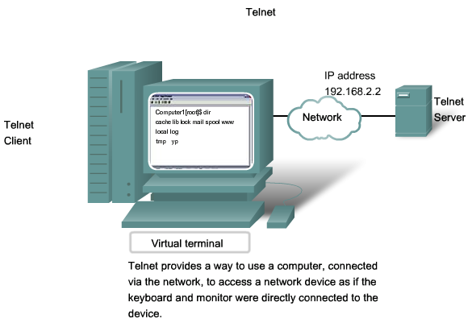
Telnet

Slide 93
File Sharing Services and SMB protocol
Server Message Block
SMB has become a mainstay of Microsoft networking, even more so since the introduction of Windows 2000 software.
Allows servers to share their resources with clients
Linux and Unix also share with Microsoft networks using a version of SMB called SAMBA.
Apple also supports sharing resources using an SMB protocol
What can SMB do?
Start, authenticate, and terminate sessions
Control file and printer access
Allow applications to send/receive messages to/from another device

Slide 94
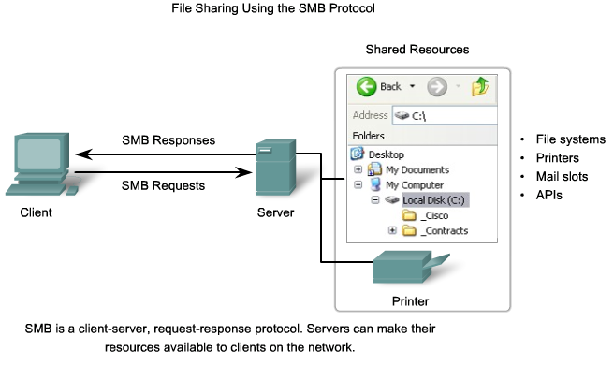
File sharing services and SMB

Slide 95
HTTP: the hypertext transfer protocol
Skills: none
IT concepts: protocol, the RFC process, communication protocol layers, application layer

Slide 96
HTTP vs HTML
HTML: hypertext markup language
Definitions of tags that are added to Web documents to control their appearance
HTTP: hypertext transfer protocol
The rules governing the conversation between a Web client and a Web server
Both were invented at the same time by the same person

Slide 97
What is a protocol?
In diplomatic circles, a protocol is the set of rules governing a conversation between people
We have seen that the client and server carry on a machine-to-machine conversation
A network protocol is the set of rules governing a conversation between a client and a server
There are many protocols, HTTP is just one
Notes:
Follow protocol – follow the rules of the conversation

Slide 98
An HTTP conversation
Client
Server
OK
Send page or error message
OK
I would like to open a connection
GET <file location>
Display response
Close connection
HTTP is the set of rules governing the format and content of the conversation between a Web client and server

Slide 99
Network protocols
The details are only important to developers.
The rules are defined by the inventor of the protocol – may be a group or a single person.
The rules must be precise and complete so programmers can write programs that work with other programs.
The rules are often published as an RFC along with running client and server programs.
The HTTP protocol used for Web applications was invented by Tim Berners Lee.
RFC = request for comments

Slide 100
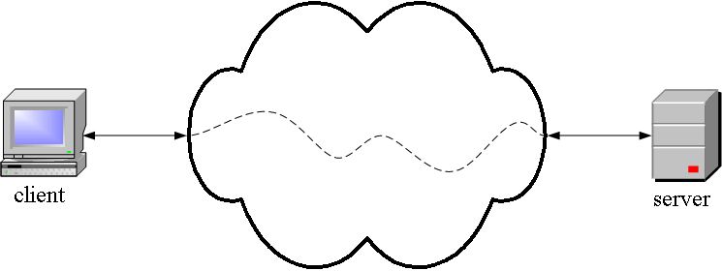
HTTP is an application layer protocol
The Web client and the Web server are application programs
Application layer programs do useful work like retrieving Web pages, sending and receiving email or transferring files
Lower layers take care of the communication details
The client and server send messages and data without knowing anything about the communication network

Slide 101
The application layer is boss – the top layer
Layer | Function
Application | Do useful work like Web browsing, email, and file transfer
Lower layers | Handle communication between the client and server
Your boss says: Send this package to Miami -- I don't care if you use Federal Express, UPS, or any other means. Also, let me know when it arrives or if it cannot be delivered for some reason.
The application program says: Send this request to the server -- I don't care how you do it or whether it goes over phone lines, radio, or anything else about the details. Just send the message, and let me know when it arrives or if it cannot be delivered for some reason.
There are five TCP/IP layers, the application layer and four lower layers.

Slide 102
Many application layer protocols are used on the Internet, HTTP is only one
Protocol | Application
HTTP: Hypertext Transfer | Retrieve and view Web pages
FTP: File Transfer | Copy files from client to server or from server to client
SMTP: Simple Mail Transport | Send email
POP: Post Office | Read email

Slide 103
MQTT Protocol

Slide 104
IoT Application Layer Protocols
Most popular application layer protocols used nowadays:
CoAP: Constrained Application Protocol
MQTT: Message Queuing Telemetry Transport
XMPP: Extensible Messaging and Presence Protocol
AMQP: Advanced Message Queuing Protocol
WebSocket: Computer Communications Protocol
Alljoyn: Full stack of protocols intended for IoT. Not separable application layer protocol

Slide 105

MQTT
Introduced by IBM
Standardized by OASIS (2013)
Uses Publish/Subscribe mechanism controlled by Broker
Broker
Software component
Responsible for distributing messages from Publishers to interested Subscribers
MQTT versions
MQTT-SN
S-MQTT

Slide 106
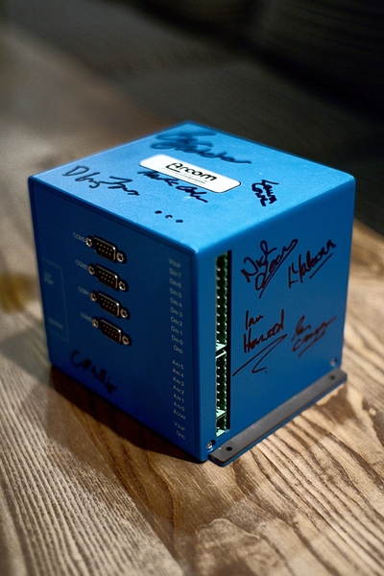
MQTT was co-invented by IBM and Arcom Systems over 13 years ago.
The current MQTT specification is available here:
http://www.ibm.com/developerworks/webserices/library/ws-mqtt/index.html
This specification is being contributed to OASIS.
It is available under an open and royalty free license.
Abstract from the MQTT spec web site: The MQ Telemetry Transport (MQTT) protocol is a lightweight publish/subscribe protocol flowing over TCP/IP for remote sensors and control devices through low bandwidth, unreliable or intermittent communications. This protocol specification has not been standardized. It is made available here under a royalty free license

Slide 107
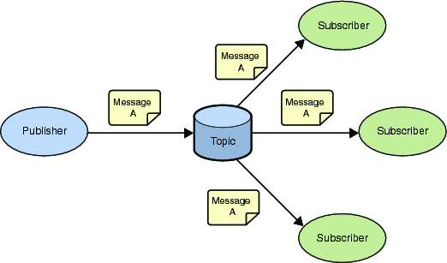
MQTT - Publish Subscribe Messaging aka One to Many
A Publish Subscribe messaging protocol allowing a message to be published once and multiple consumers (applications / devices) to receive the message providing decoupling between the producer and consumer(s)
A producer sends (publishes) a message (publication) on a topic (subject)
A consumer subscribes (makes a subscription) for messages on a topic (subject)
A message server / broker matches publications to subscriptions
If no matches the message is discarded
If one or more matches the message is delivered to each matching subscriber/consumer

Slide 108
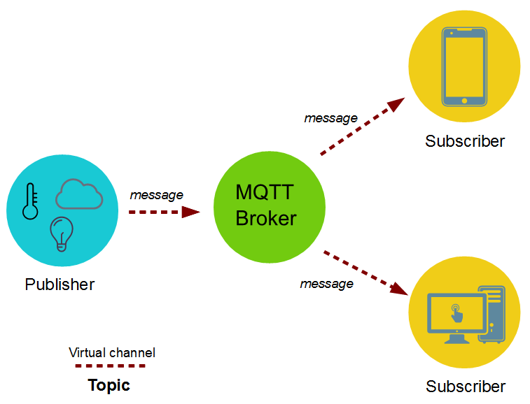
MQTT component details
Many – to – many Sub to Pub relationship
One Broker for every system
Subs authenticated to Broker
Subs/Pubs can be very constrained
Pub can be even only a sensor
Broker has to provide more computational power

Slide 109
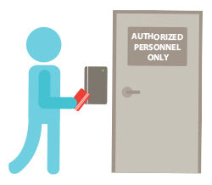
Access Control
What
Restrictions in order to enforce policies
Effect
Permission/Denial of access to a specific resource

Slide 110
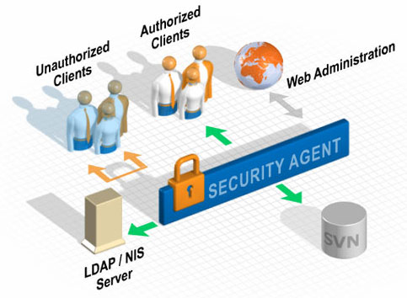
Access Control Policy
Set of rules that allow/deny access
Rules depend on attributes
Access control evaluates attributes only once at request time

Slide 111

Attribute mutability
Conditions may change during time
So do attributes
New attribute values may affect conditions
What if they violate policy?

Slide 112
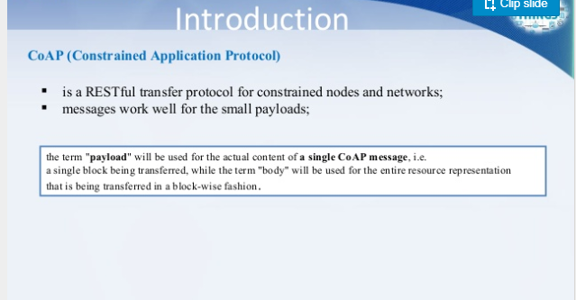
COAP

Slide 113
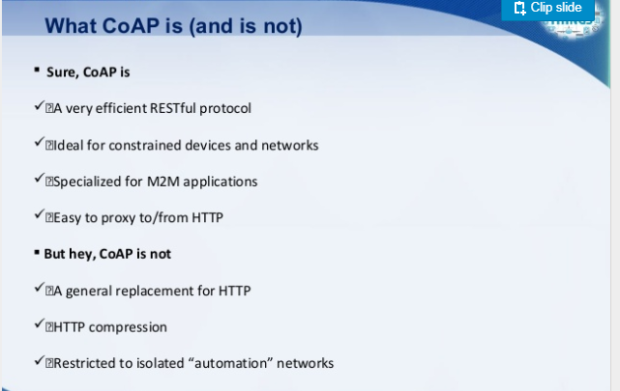

Slide 114
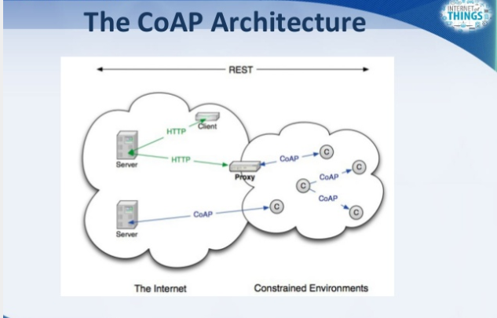

Slide 115
